Slide 1
The Right to Health
Protecting women from effects of tobacco and tobacco smoke
By Fifa Rahman

Slide 2
Numbers
46.4%
7000
69/7000
RM 90 million
RM 20 billion
600,000
⅓
25%
male smokers
harmful chemicals
Carcinogens
profits earned by the tobacco industry
spent treating tobacco-related illnesses
dead from passive smoking.
= children
increased risk.

Slide 3
Is there a concrete right to health?
CEDAW Article 11(1)(f)
ICESCR Article 12.1

Slide 4
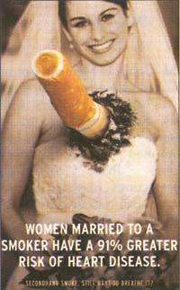
But, does secondhand smoke really kill?
Non-smokers living with smokers have a higher risk of heart disease.
Children living with smokers report increased frequency of asthma attacks.
10% of all lung cancer diagnoses are among non-smokers. Minus asbestos, genetics.
Notes:
Daniel Lee Prince Court, Malaysian Oncology

Slide 5
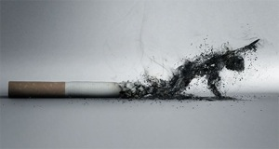
But lung cancer is for old people!
Tints your skin.
Stains your teeth.
Increases wrinkles.
Affects fertility.

Slide 6
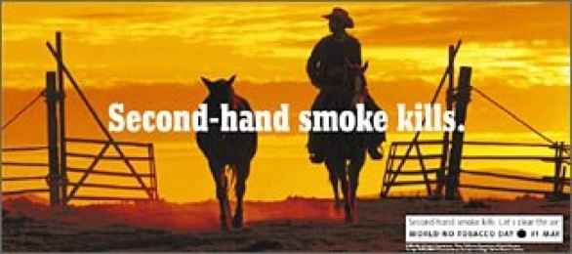
What can you do?
Ultimatum.
Gently?
Load em with statistics.
Support smoke-free areas. (Zones, cafes, workplaces)
Notes:
Umair,

Slide 7
Sign of the Times

Slide 8
POVERTY
POVERTY is a human rights violation.

Slide 9
Thou shalt not be a victim!
Thou shalt not be a perpetrator
Above all, thou shalt not be a Bystander.
- Holocaust Museum, D.C.

